Slide 1


Slide 2



iD Lab
Smart SOC – Retrieval System

Slide 3
Project Background
Evolving SOC Codes: SOC codes are periodically revised, making it difficult to match job duties with the most current codes. This leads to potential visa denials and compliance issues for industries relying on precise job classification.
Complexity of Job Descriptions: Immigration lawyers and other professionals must compare detailed job duties with SOC codes, a process that can be time-consuming and prone to human error.
Existing Solutions: Current systems either rely solely on keyword-based searches or manual selection, both of which fail to capture the nuances of job descriptions and evolving SOC codes.

Slide 4



Proposed Approach
Hybrid Search: Combines BM25 keyword search with embedding-based search for enhanced accuracy, leveraging both semantic understanding and keyword relevance.
Embedding Models: Embedding-Ada generates semantic embeddings for deeper contextual comparison of job descriptions and SOC codes.
Cosine Similarity & BM25 Ranking: Filters and ranks up to the top 10 SOC codes using both cosine similarity (semantic closeness) and BM25 (keyword relevance).
LLM Integration: LLM evaluates ranked SOC codes, selects the best match, and provides explanations, boosting transparency and trust.

Slide 5
Live Demonstration
Input: User submits a job description or query for SOC code classification via a user-friendly interface.
Processing: The system preprocesses the query by chunking, tokenizing, and generating embeddings. It also runs a BM25 keyword search.
Ranking: Results are ranked based on cosine similarity and keyword matching, presenting the top 10 SOC codes.
Explanation: The system selects the best SOC code using the LLM and provides a detailed explanation for the choice.
Output: The top-ranked SOC code, along with similar codes, is returned to the user in real-time.

Slide 6
Applications and Benefits
Immigration Law: Ensures the correct SOC code is chosen for visa applications, reducing the risk of denial or compliance issues.
HR and Recruitment: Assists in job classification and matching candidates to positions based on SOC codes, streamlining talent acquisition.
Government Agencies: Helps with workforce planning and statistical data analysis by automating SOC code categorization for job descriptions.
Job Market Analytics: Companies using this system can gain insights into market trends and employment categories by analyzing SOC code distributions across industries.
CPT Codes (medical insurance) Matching medical procedures to correct CPT codes
Other Insurance classifications

Slide 7
System Design
Data Sources: SOC code database (e.g., O-Net Online) and JSON storage for embeddings and tokenized documents.
Preprocessing Layer: Tokenization, chunking, and embedding generation using the Ada embeddings model.
Search Engine: Hybrid search combining BM25 for keyword matching and cosine similarity for semantic search.
LLM Decision Layer: Large Language Model processes and ranks the top SOC codes and provides the final classification with an explanation.
API Integration: Real-time processing of user queries through an API, returning the top SOC codes with explanations.

Slide 8
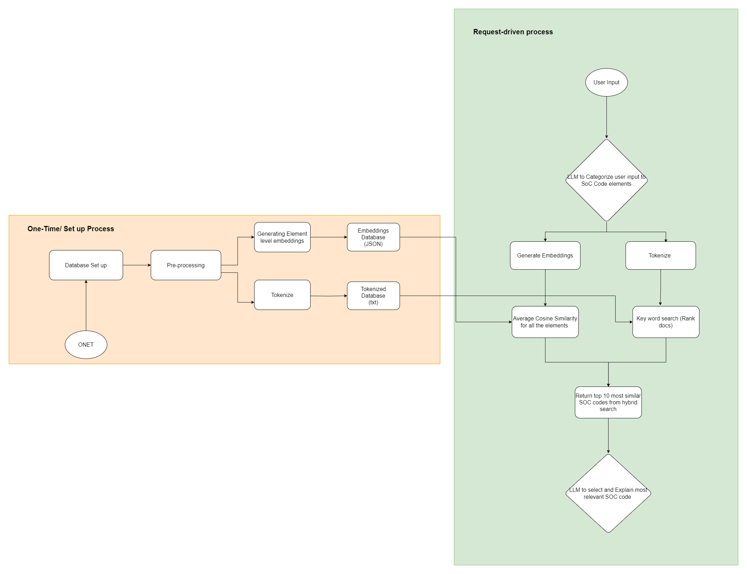

Slide 9
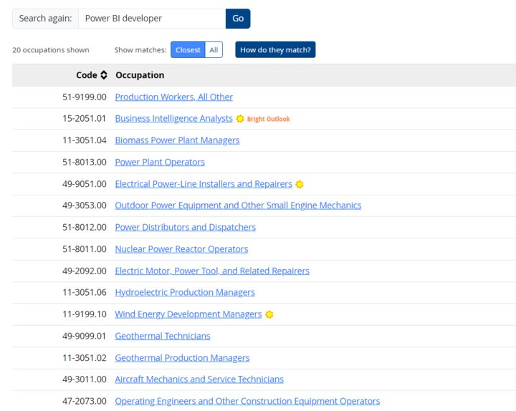
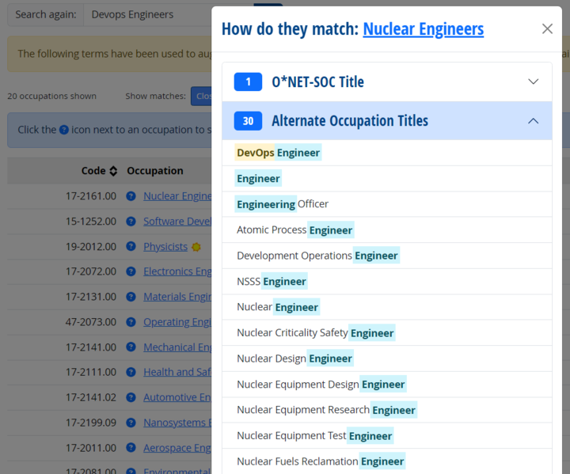
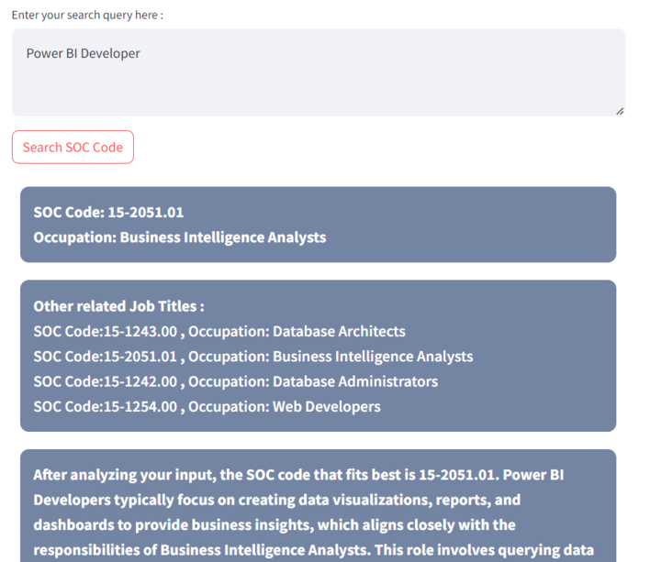
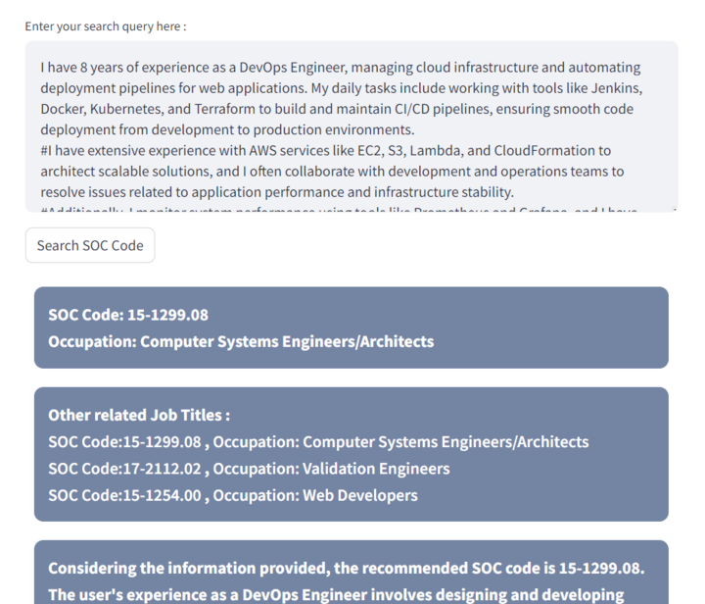

Slide 10
Major Business Values
Improved accuracy and consistency
Time and cost savings
Enhanced compliance
Support for wage determinations
Notes:
Dr. Enid Montague
Douglas Bruce
Elissa Foster
Degnan Lawrence

Slide 11


Thank You

